Slide 1
Introduction to Python Programming using Fabric Notebooks
Ted Pattison
Principal Program Manager
Fabric CAT Team

Slide 2
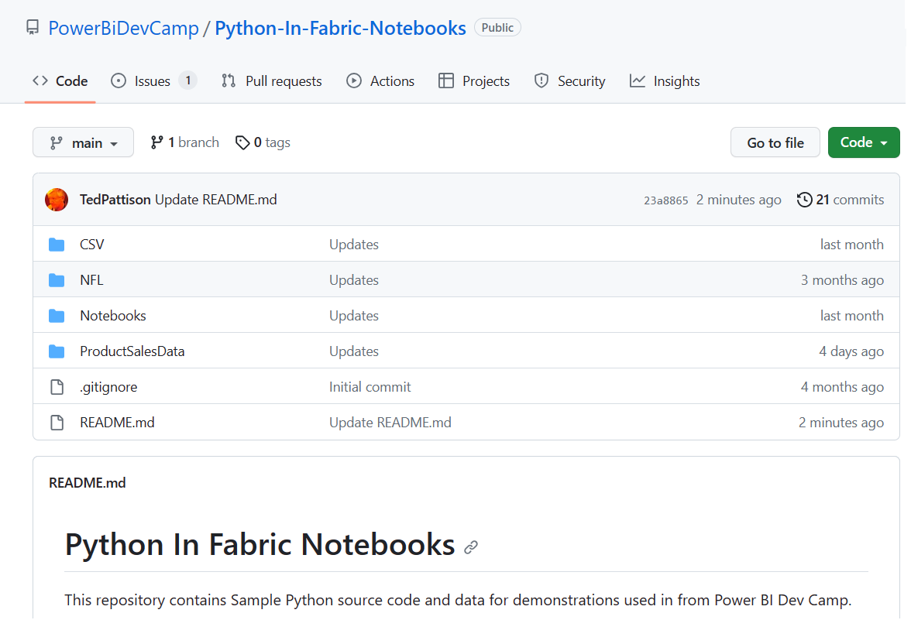
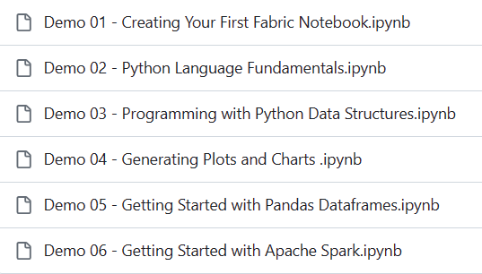
GitHub Repository with Demo Code for This Session
Available at https://github.com/PowerBiDevCamp/Python-In-Fabric-Notebooks

Slide 3
Agenda
Getting Started with Fabric Notebooks
Learning Python Language Fundamentals
Programming Python Data Structures
Generating Plots and Visualizations
Programming Dataframes with Pandas
Understanding Apache Spark

Slide 4
Executing Python Code in Fabric
Python is an interpretive language, not a compiled language
Python code needs a runtime layer to execute
Microsoft Fabric provides Python 3 runtime support with Apache Spark
Python code can be executed through Spark Job Definition
Python code can be executed using interactive Fabric Notebook
Apache Spark provides APIs to read and write data to/from Lakehouse in OneLake
Microsoft Fabric
Fabric
Spark Job
Apache Spark
Lakehouse
Python Runtime
Fabric
Notebook

Slide 5


Common Use Cases for Fabric Notebooks
Python is very popular language for Data Engineering and Data Science use cases
Spark provides APIs for performing ETL and storing data as Lakehouse tables in OneLake
Data can be refined using medallion structure with zones for bronze, silver and gold
Data written to Lakehouse tables is accessible through SQL Endpoint
Machine learning models can be trained and tested directly on the Lakehouse
OneLake
Azure Gen2 Storage
SQL Endpoint
Explore & Visualize
Lakehouse
Machine Learning Models
Experiments & Training
Lakehouse
Visualize & Analyze

Slide 6
Introducing Fabric Notebooks
Notebook provides web interface to write and execute Python code
Fabric Notebooks represent evolution of iPython and Jupiter Notebooks
Author is able to write and test Python code within interactive user experience
Notebooks support PySpark (Python), Spark (Scala), Spark SQL and SparkR (R)
Notebook mixes [markdown text] + [code] + [visualizations] in single file
Behind the scenes, notebooks are stored as JSON files with .ipynb extension
You create and author notebooks by adding cells
Notebook cells can be added as code cells or markdown cells
Notebook created with default language for code cells
Individual code cells can be configured with different language
Fabric Notebook
markdown
python code
markdown
python code

Slide 7
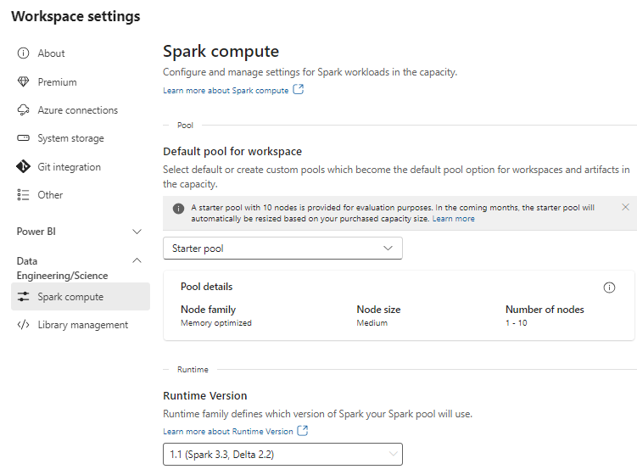
Understanding Spark Pools and Spark Sessions
Python code in Fabric Notebook executed in context of Spark pool
Fabric infrastructure manages Spark pools behind the scenes – that's the beauty of a SaaS model
Fabric pre-configures Starter pools to get you up and running quickly
Fabric provides configuration options to scale up and/or scale out with nodes

Slide 8
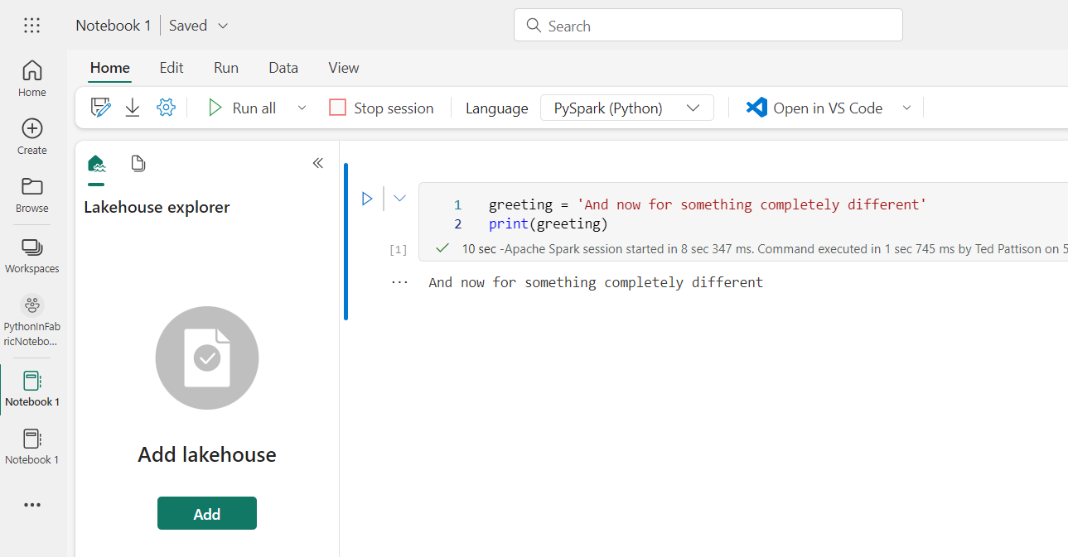
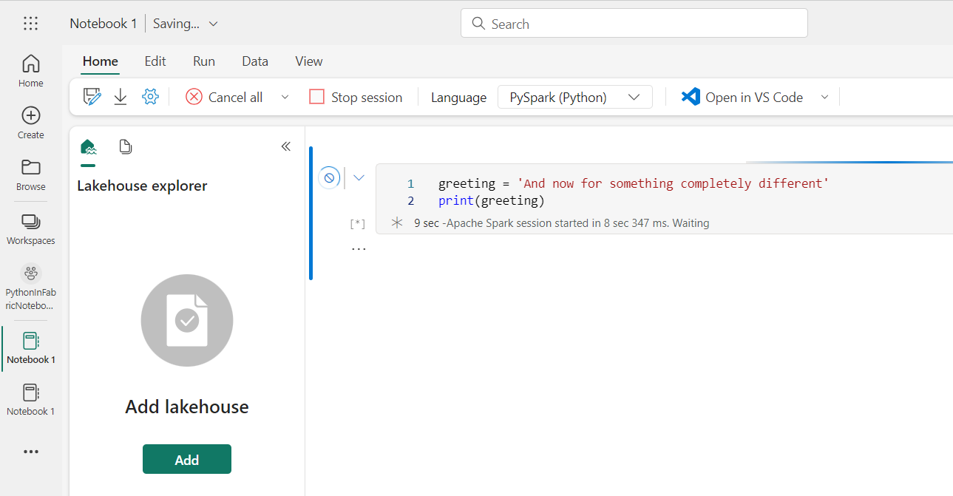
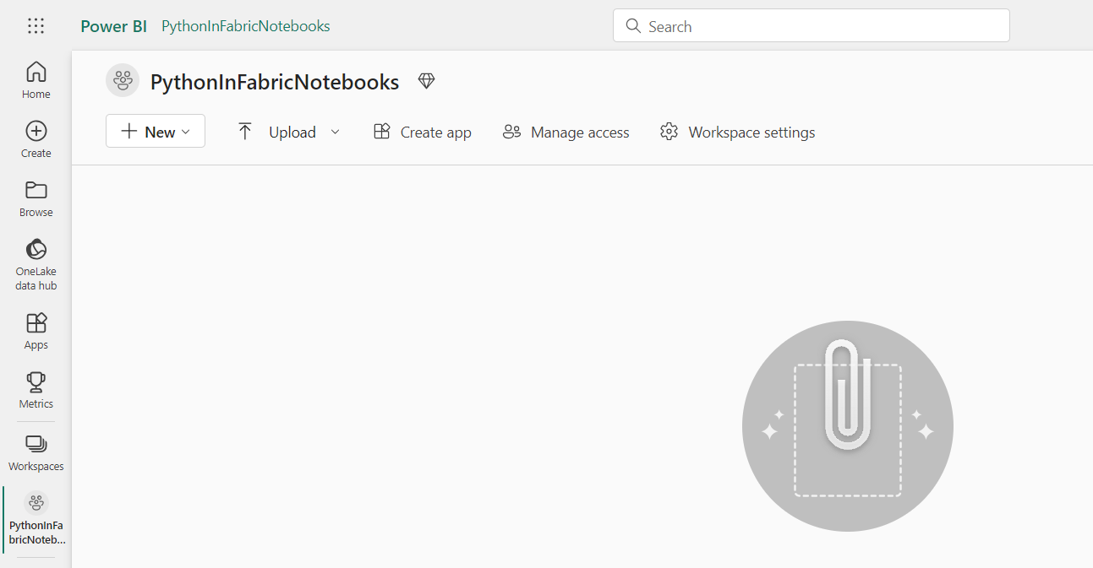
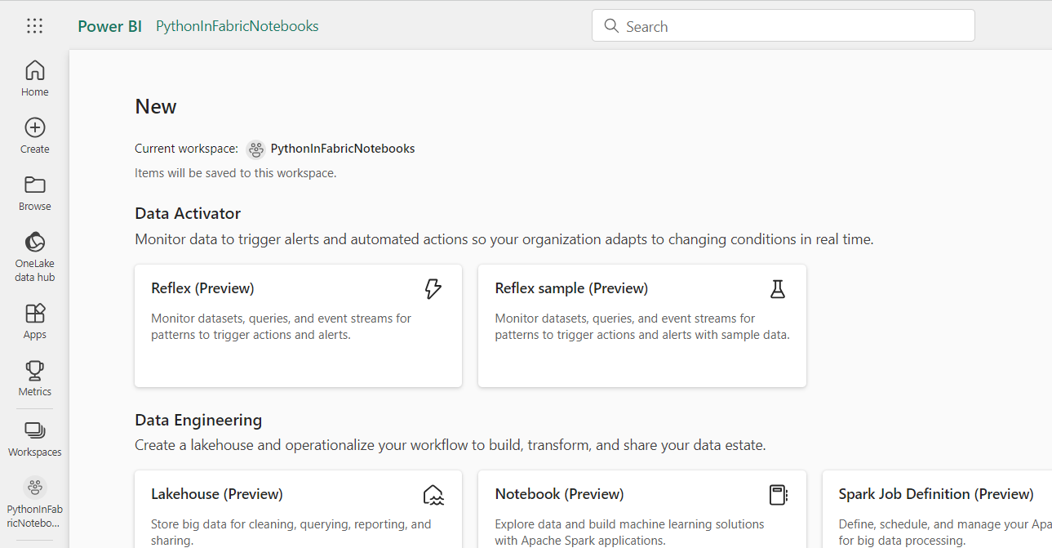
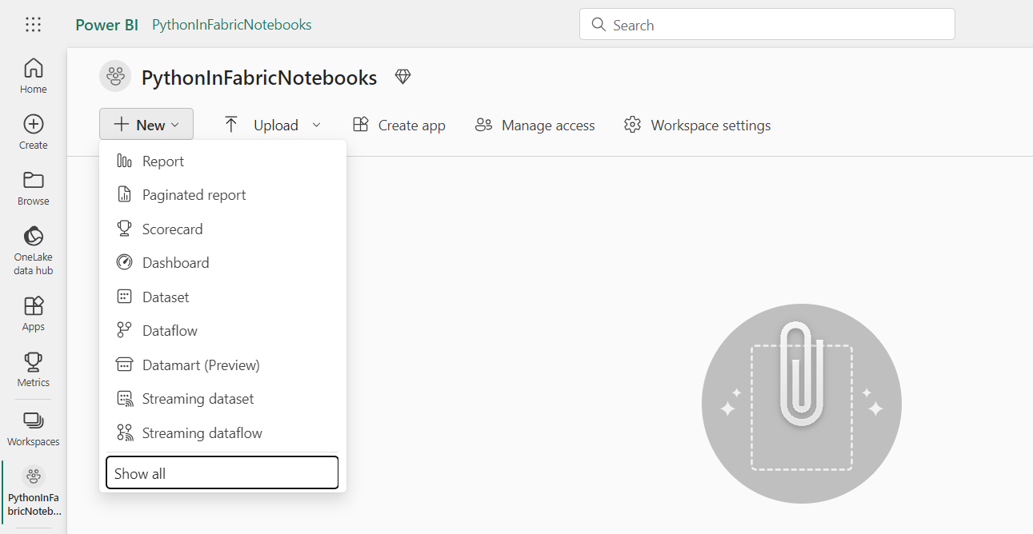
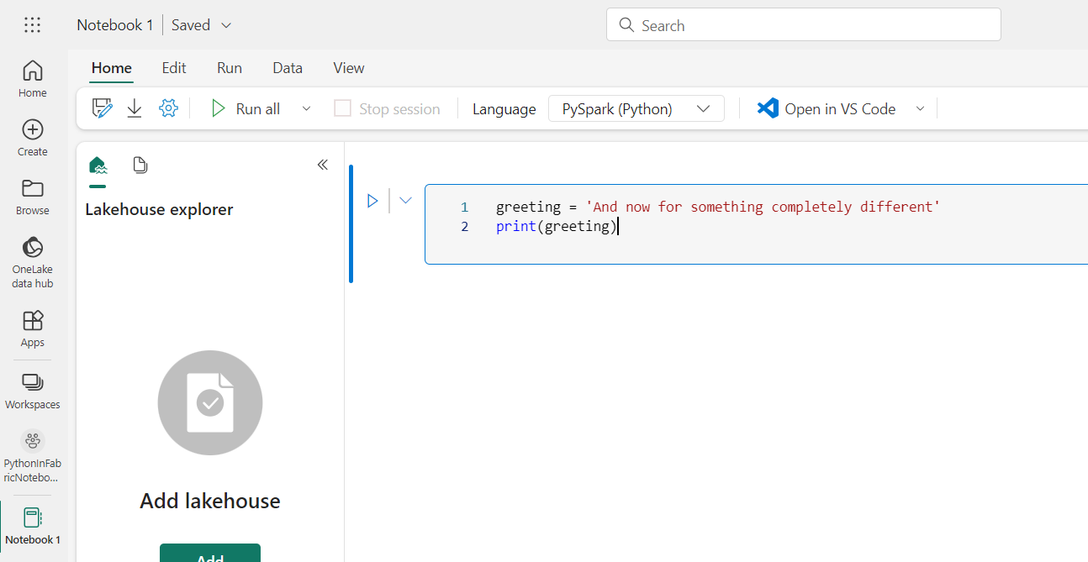
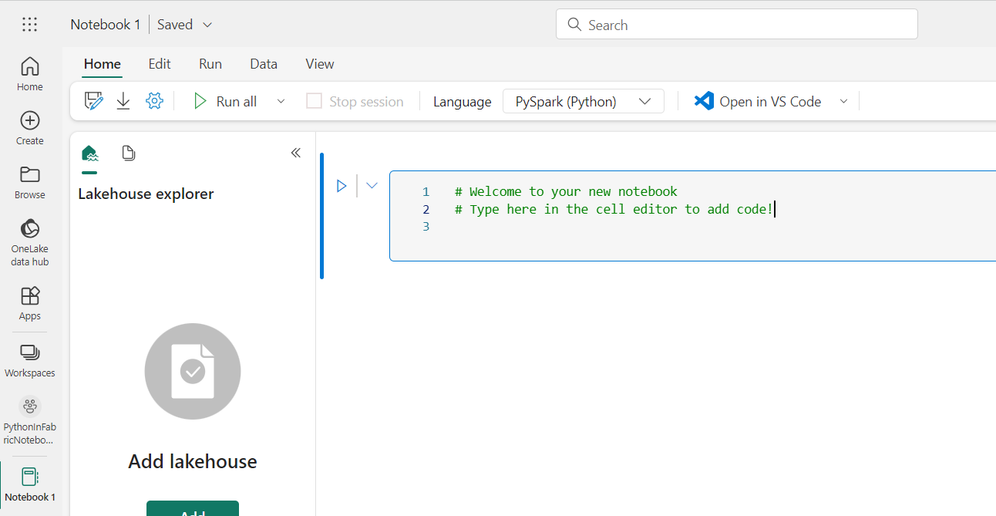
Creating a Fabric Notebook
Steps to create a Fabric Notebook within a workspace

Slide 9
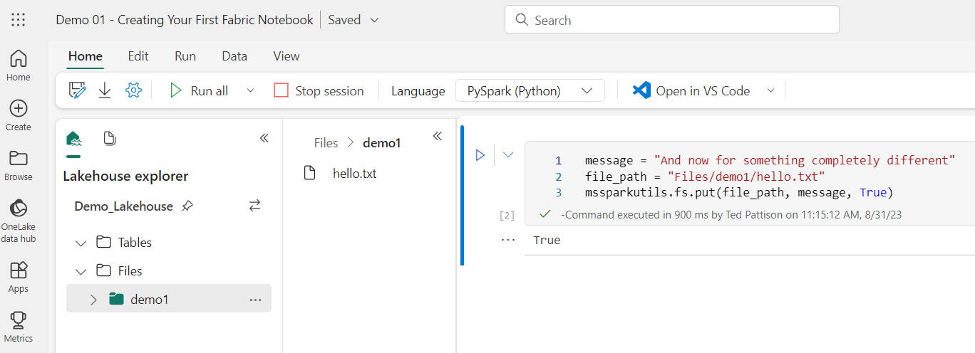
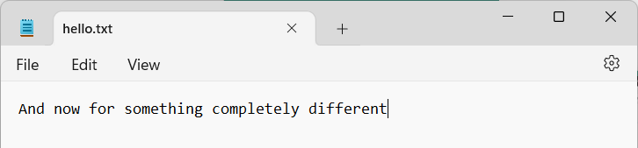
Creating a New File in the Lakehouse File System
Fabric support for Python includes mssparkutils module
mssparkutils provides library of convenient utility APIs to increase productivity
Direct access to file system of Lakehouse available using mssparkutils.fs object
You can use mssparkutils.fs.put to create new file in Lakehouse storage

Slide 10
Agenda
Getting Started with Fabric Notebooks
Learning Python Language Fundamentals
Programming Python Data Structures
Generating Plots and Visualizations
Programming Dataframes with Pandas
Understanding Apache Spark

Slide 11
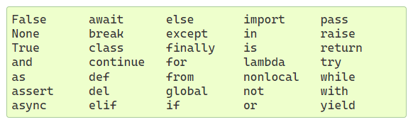
Python Language Fundamentals
Python is case-sensitive, interpretive and procedural language
Python is loosely-typed in a fashion similar to JavaScript and PowerShell
Python is not strongly-typed – It lacks type safety found in C#, Java and Scala
Getting started with Python syntax
Learn to structure code using colons and indentation
Add comments using #
Begin learning all the Python language keywords as you go…

Slide 12
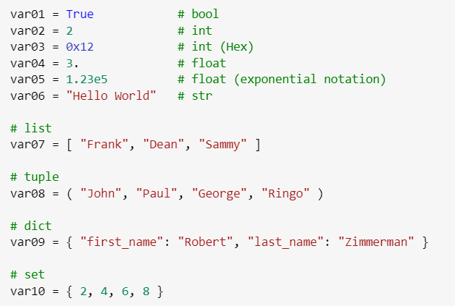
Understanding Python Objects and Variables
Any data or value accessible in Python is considered an object of a specific type
Python variables declared implicitly inline without any type and without using explicit keyword
After initial assignment, variable references object that has a specific type
Simple value types like int and float enclosed in wrapper objects with methods and attributes

Slide 13
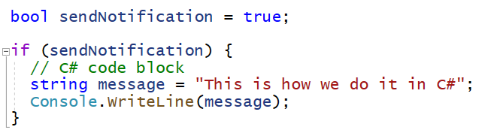
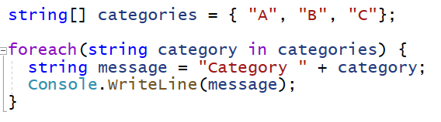
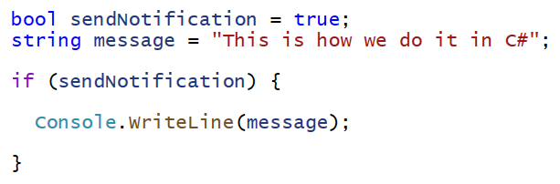
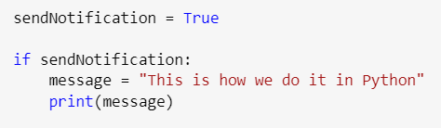
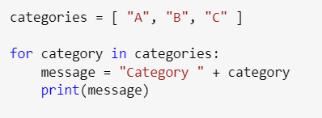
Structuring Code Blocks using Colons and Indentation
In C#, code blocks structured using semi-colons ( ; ) and curly braces ( { } )
In Python, code blocks structured using colons ( : ) and indentation

Slide 14
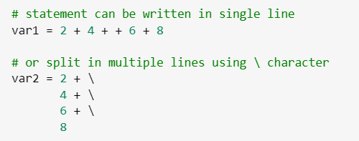
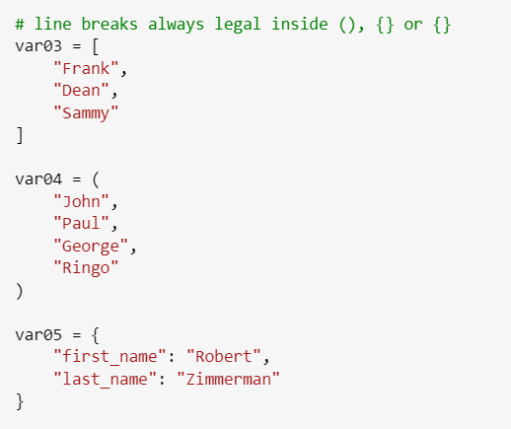
Line Breaks and the Continuation Character
Python is sensitive to line breaks
Line breaks are allowed inside parenthesis ( ), square brackets [ ] or curly braces { }

Slide 15
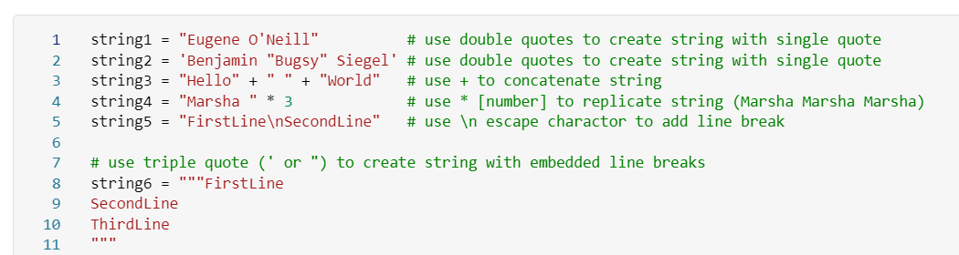
Adding Literal String Values
Literal strings can be enclosed within single quotes (') or double quotes (")
Triple quotes (''' or """) used to create multi-line string with line breaks
Python provides typical set of functions for programming with strings
str(), len(), split(), join(), replace(), strip(), find(), etc.

Slide 16
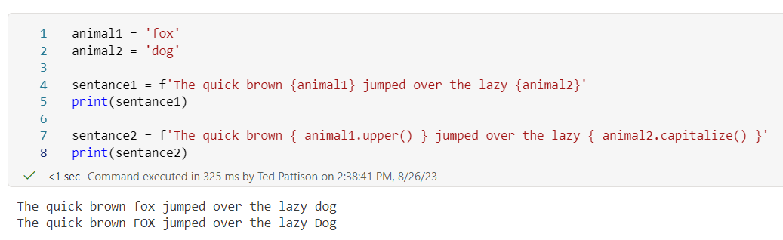

f-Strings and r-Strings
Formatted strings (aka f-strings) provide dynamic text parsing
Raw strings (aka r-strings) used to create strings without any encoding

Slide 17
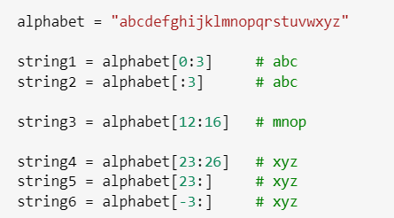
Parsing Strings with Slicer Syntax
Python supports slicer syntax with strings and lists
Slicer syntax uses square brackets with inner colon [ : ]
Consider a few simple examples of extracting text using slicer syntax
[:] | Extract entire string
[ start:] | Extracts from start offset to end
[: end] | Extracts from start to end offset minus 1
[ start : end ] | Extracts from start offset to end offset minus 1
[ start : end : step ] | Extracts from start offset to end offset minus 1by step increment

Slide 18
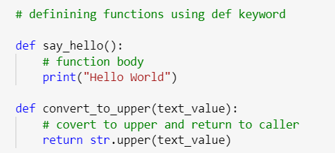
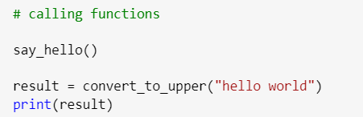
Defining and Calling Functions
Define functions using def keyword and parenthesis () with parameter list
Optionally add return statement to return object back to caller
Call functions by passing parameters in parenthesis
Capture function return value if these is one

Slide 19
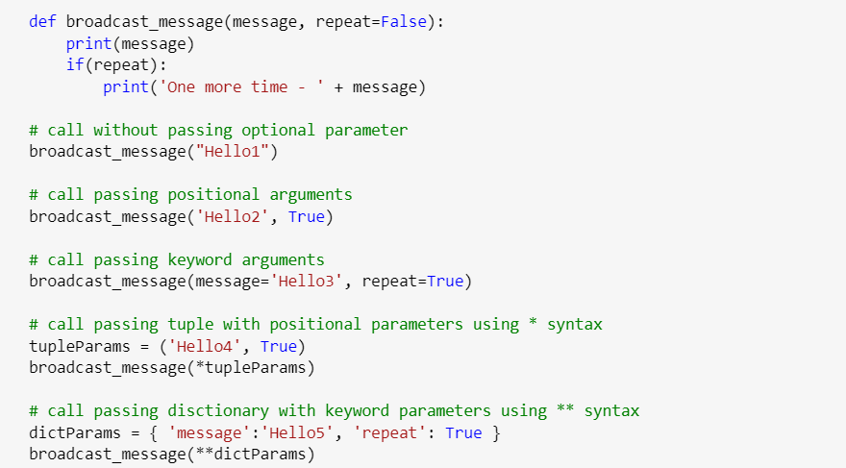
Defining Function Parameters
Function parameters can be defined as mandatory or optional
Define optional parameters to right of mandatory parameters by providing default value
Function parameters can be passed as positional parameters or as keyword parameters
The following examples show different ways to call broadcast_message()

Slide 20
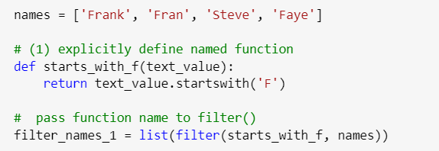
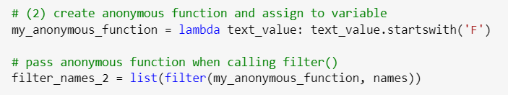
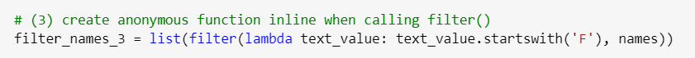
Creating Anonymous Functions using lambda Keyword
Some python functions (e.g. filter) accept other functions as parameters
Anonymous function can be defined using lambda keyword
It's more concise to create anonymous functions using in-line syntax

Slide 21
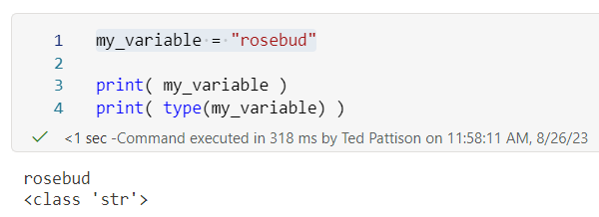
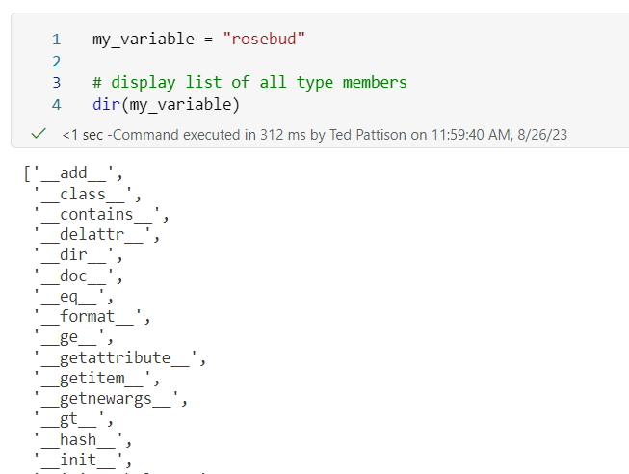
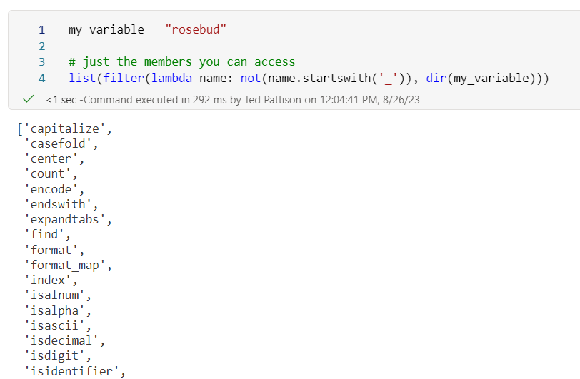
Using Reflection To Inspect Object Type and Membership
Use type() to inspect object type
Use dir() to enumerate through list of object attributes and methods

Slide 22
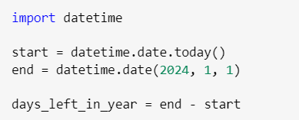
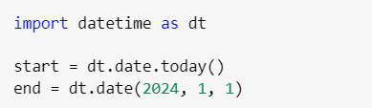
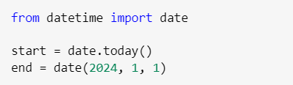
Importing Modules
Importing a module using import
Importing a module with a different name using import and as
Importing specific objects and types from module using from and import

Slide 23
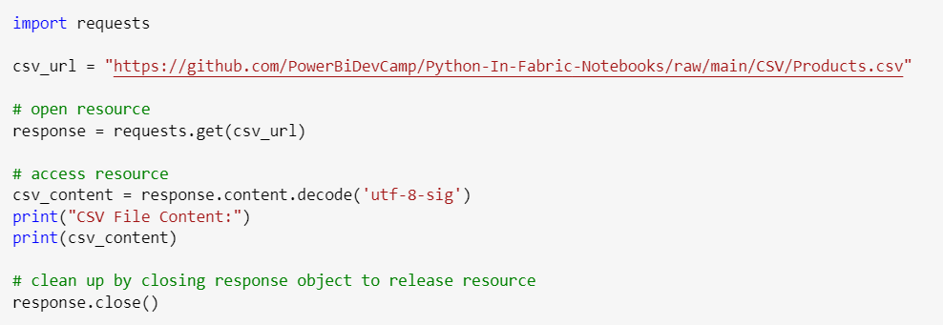
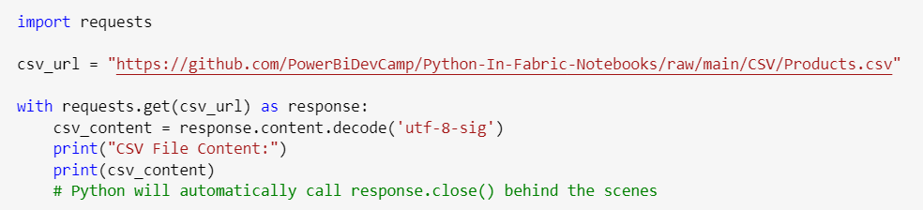
Python with Statement
Python provides with statement for use with resources that should be closed
Example of making HTTP request using requests.get() without using with statement
When using with statement, Python runtime will automatically clean up object and call close()

Slide 24
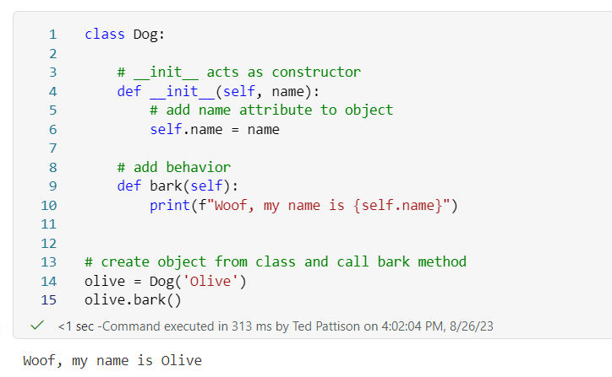
Getting Started with Object-oriented Programming
Python provides syntax for creating classes
Enables creating reusable code with object-oriented programming principals
You can override magic functions such as __init__(), __str__(), __repr__()

Slide 25
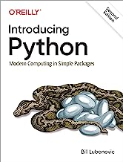
Further Reading on Python Language Fundamentals
Introducing Python: Modern Computing in Simple Packages
By Bill Lubanovic

Slide 26
Agenda
Getting Started with Fabric Notebooks
Learning Python Language Fundamentals
Programming Python Data Structures
Generating Plots and Visualizations
Programming Dataframes with Pandas
Understanding Apache Spark

Slide 27
Essential Python Data Structures
Python built-in data structures
Tuple
List
Dictionary
Set
From NumPy library
Multi-dimensional array
From Pandas library
Series
DataFrame
Index

Slide 28
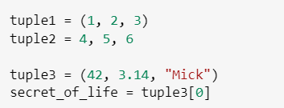


Tuples
Tuple is fixed-length, immutable sequence of heterogeneous objects
Once initialized, tuple contents cannot be modified
Creating tuple using parentheses () is recommended for readability but not required
Access tuple elements using square brackets [] and zero-based index
Tuple can be unpacked to multiple variables
Unpacking tuple requires correct number of variables or error will occur

Slide 29

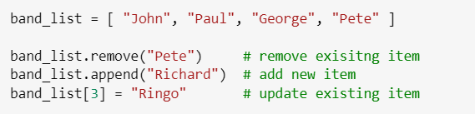

Lists
List is variable-length, updatable sequence of heterogeneous objects
Use square brackets [] to create list and to access items using zero-based index
Provides support for adding, updating and removing objects from list
Lists support slicer [ start : end ] syntax similar to strings

Slide 30
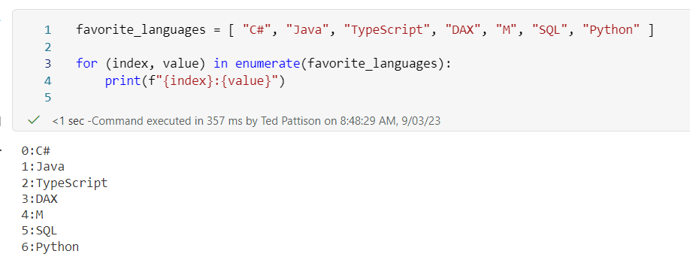
Simple List Enumeration
Enumeration in Python based on Generator Functions
Generator Function returns an iterator object
You can enumerate through collection using iterator object and for loop
Here is example of enumeration with for loop using Generator Function named enumerate()

Slide 31
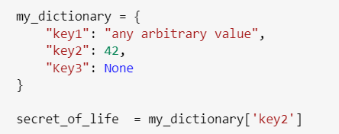
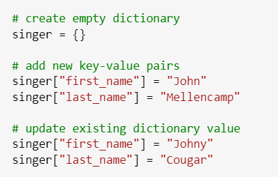
Dictionaries
Dictionary stores associative array of key-value pairs
Dictionary created using curly braces { } with enclosed key-value pairs
Dictionary items accessible using square brackets with enclosed key
Use dictionary[ key ] syntax to add or update items in dictionary

Slide 32
Calling Functions By Passing Tuples and Dictionaries
Python allows passing function parameter list as tuple or as dictionary
Consider the following function
Call function with tuple to pass positional parameters using * syntax
Call function with dictionary to pass keyword parameters using ** syntax

Slide 33
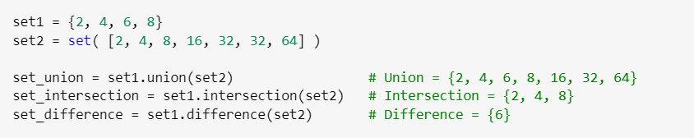
Sets
Set stores unordered collection of unique elements
Created using either curly braces {} or by passing list to set() function
Provides mathematical set operations like union(), intersection() and difference()

Slide 34
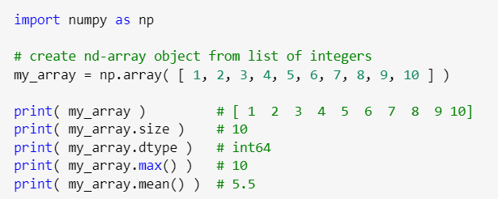
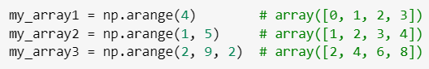
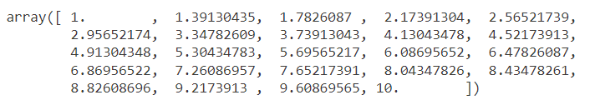
Introducing NumPy Arrays
Numerical Python (NumPy) library provides high-performance array type (ndarray)
ndarray object is n-dimensional array of homogeneous-type objects
Create ndarray object from list using NumPy array() function
Create ndarray object containing sequence of numbers using np.arrange()
Create ndarray object containing numbers with linear spacing using np.linspace()

Slide 35
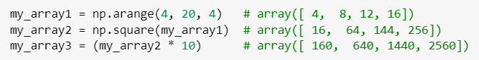

Updating NumPy Arrays using Vectorized Operations
NumPy arrays support efficient write operations using vectorized computation
Vectorized operation used to perform mathematical updates on every item in array
Vectorized operation provides fast and easy way to update all array items without looping
Syntax for vectorized operation involves performing operation directory against array
NumPy arrays support broadcasting allowing mathematical operations between arrays
Simple example involves multiplying two arrays to create multiplication product array

Slide 36
Agenda
Getting Started with Fabric Notebooks
Learning Python Language Fundamentals
Programming Python Data Structures
Generating Plots and Visualizations
Programming Dataframes with Pandas
Understanding Apache Spark

Slide 37

Plotting Libraries for Python Developers
Popular plotting and charting libraries built into Fabric Apache Spark
Matplotlib
Seaborn
Plotly
See what other Python libraries are included with Fabric Apache Spark
https://learn.microsoft.com/en-us/fabric/data-engineering/runtime#default-level-packages-for-python-libraries

Slide 38


Getting Started Generating Charts with Matplotlib
Matplotlib has become de facto standard in Python for generating plots and charts
By convention, matplotlib.pyplot is imported using name plt
plt object provides plotting and charting methods such as plt.pie() and plt.bar()
Call plt.show() to display figure as generated image below current notebook cell

Slide 39



Applying Matplotlib Themes
Matplotlib provides built-in theming feature used to style plots and charts
Fabric automatically includes set of Matplotlib themes
Matplotlib provides ability to create custom themes
Call plt.style.use() and pass theme name to apply a theme
Changing Matplotlib theme affects all future chart generation in current Spark session
Theme='ggplot'
Theme='seaborn-v0_8'
Theme='dark_background'

Slide 40

Figures and Plots
Matplotlib chart generation based on Figures and Plots
Figure is top level object which gets converted into an image file such as a PDF
Plot is rectangular area inside figure where plot or chart is rendered
You can create figures whose layouts contain multiple plots
Simple example of calling figure.add_subplot() to explicitly add a plot to a figure
Figure
Plot 1
Plot 2
Plot 3
Plot 4
Plot 5
Plot 6

Slide 41

Generating Figures with Multiple Plots
Figure can be created with multiple subplots
Call plt.subplots(number_of_rows, number_of_columns) to create figure layout of plots
Consider this example which creates a figure whose layout contains two subplots
plots[0]
plots[1]

Slide 42

Using Seaborn To Create Graphs and Charts
Seaborn is popular chart library which is built on top of Matplotlib
Seaborn provides productivity by hiding low-level details required when using Matplotlib
Seaborn provides rich and easy-to-use support for working with pandas DataFrames

Slide 43


Save Plots and Charts as Lakehouse Files in OneLake
Fabric notebooks make it easy to save plots and charts as image files in OneLake
Ensure target folder exists by calling mssparkutils.fs.mkdirs()
Construct file path to Lakehouse Files folder in the format of /lakehouse/default/Files/…
Call plt.savefig() to save image file to file system of Lakehouse

Slide 44
Agenda
Getting Started with Fabric Notebooks
Learning Python Language Fundamentals
Programming Python Data Structures
Generating Plots and Visualizations
Programming Dataframes with Pandas
Understanding Apache Spark

Slide 45
Pandas Overview
Pandas is popular Python library built on top of NumPy
Pandas leverages NumPy multi-dimensional array and NumPy data types (dtypes)
Pandas is focused on programming tabular datasets with heterogenous data (rows and columns)
Pandas extends NumPy by allowing for heterogeneous datatypes across columns
Pandas models relational tables using separate ndarray object for each column
Pandas library introduces several essential data structures
Series
Dataframe
Index
Dataframe
Series
Product:
Apples
Bananas
Carrots
Potatoes
Series
Sales:
174187
70395
89564
167810
Index
0
1
2
3

Slide 46

Series Objects
Series is one-dimensional ordered dictionary of homogeneous values
Series object can be created by passing list to Series function
Series object always has index which is either created explicitly or implicitly
Behind the scenes, Series object uses ndarray object to cache and manage data
All values in Series object must have same dtype based on types defined in NumPy library
Whenever required, you can access ndarray object contained by Series object
Series
ndarray (dtype=int64)
30000
42000
24000

Slide 47


Series Objects
Every Series object is initialized with a specific dtype
If you don’t explicitly set dtype, it will be set implicitly using data inference
Whenever required, you can explicitly set dtype when creating a Series object

Slide 48


Programming with Series Objects
Series object provides statistical methods
You can call methods such as count(), sum(), mean(), median(), etc.
Series object supports vectorized operations
Series object leverages vectorized operation support in underlying ndarray object

Slide 49
DataFrame Objects
DataFrame represents a rectangular table of data
DataFrame contains ordered collection of columns
Each column represented by Series objects with column name and column values
All Series objects in DataFrame share a single index
Dataframe
Series
ndarray (dtype=Object)
Product:
Apples
Bananas
Carrots
Potatoes
Series
ndarray (dtype=int64)
Sales:
174187
70395
89564
167810
Index
0
1
2
3

Slide 50


Creating Your First DataFrame
Steps to create a simple Pandas DataFrame
By convention, pandas module imported as name pd
Call pd.DataFrame() passing dictionary of name-list pairs
All columns must be created with same number of items
Alternatively, call pd.DataFrame() passing dictionary of name-Series pairs

Slide 51

Using Seaborn To Create Chart from Dataframe
Seaborn library makes it relatively easy to produce charts from Pandas DataFrames

Slide 52

Extracting Data from CSV Files with Pandas
Pandas provides rich support for importing data from various data format
You can import and extract data from common file types such as CSV, JSON, HTML, etc.
Pandas library provides import functions such as read_csv() and read_json()

Slide 53


Saving DataFrames as Lakehouse Files in OneLake
Pandas makes it easy to persist DataFrame into common file formats
DataFrame can be save in file formats such as CSV, JSON and XML
Data files can be saved to folders in Lakehouse

Slide 54

Data Wrangling using Pandas DataFrame
Example data wrangling modifications when importing data from Customers.csv
Call to pd.read_csv() parameterized to parse dates in DOB column
Parse FirstName and LastName columns together in new column named Customer
Create new column named Age which calculates customer age from DOB column
Drop FirstName and LastName columns

Slide 55

Creating Histogram of Customer Count by Country
Using Seaborn to create a histogram from data inside Pandas DataFrame

Slide 56


DataFrame describe()
Pandas DataFrame object expose describe() method to analyze data in DataFrame
Imagine you have just loaded a large DataFrame and want to see statistics on the data
You can call describe() to see statistics on numeric column values

Slide 57

Merging Products and Sales
Pandas library provides merge() function to perform table joins
This example joins Products table with Sales table using ProductId as join key

Slide 58


Slide 59
Data Wrangling UI in Fabric Notebooks
Discuss UI support

Slide 60

Further Reading on Pandas Programming
Python for Data Analysis: Data Wrangling with pandas, NumPy, and Jupyter
Wes McKinney

Slide 61
Agenda
Getting Started with Fabric Notebooks
Learning Python Language Fundamentals
Programming Python Data Structures
Generating Plots and Visualizations
Programming Dataframes with Pandas
Understanding Apache Spark

Slide 62

Apache Spark Fundamentals
What is Apache Spark?
Open source project with over 2,000s contributors created in 2009
Unified computing engine which enables memory scale-out and parallel processing
Unified computing engine which is storage neutral and supports popular cloud storage formats
Developer platform with rich set of libraries for data analysis, machine learning and AI
Developer platform with programming language support for Scala, Java, Python, R and SQL
Rich support for batch processing, stream processing, large-scale SQL, machine learning and AI
You Are Here

Slide 63
Pandas DataFrame versus Spark DataFrame
Pandas DataFrame must load into memory available on a single node
Pandas DataFrame size limited by memory available on single computer
Calculations on large datasets limited in performance due to sequential processing
Spark DataFrame loaded and processed across multiple nodes
Rows from tables split out into multiple partitions
Table with multiple partitions can be loaded across multiple nodes
Key value proposition of Spark is scale-out strategy to load and process large DataFrames
Pandas DataFrame
Spark DataFrame
Single Node
Cluster Manager
Worker Node 1
Executor
Driver Program
Partition 1
DataFrame
Master Node
Worker Node 2
Executor
Driver Program
Partition 2
Worker Node N
Executor
Partition N

Slide 64
Understanding Lazy Evaluation, Transformations and Actions
DataFrame manipulation
Partitions are used to divide number of rows and distribute them across nodes
Spark data structures are immutable => modifying dataset means creating copy with changes
Spark scaling strategy based upon concept of lazy evaluation – don't do any work until required
Spark API provides transformations which can be delayed and recorded into work plan
Work plan is computation graph which is tuned using cost-based optimization
Spark API provides actions which trigger the execution of all pending transformations
Cluster Manager builds execution plan when diving jobs into tasks
Plan is optimized to use lazy evaluation
Think of this as similar to query folding in Power Query with M language
Provides fault tolerance - task sent to failing node can be reassigned to another nodes

Slide 65
Spark Cluster Computing Enables Parallel Processing
Spark scales by distributing processing tasks across multiple worker nodes
Spark uses cluster manager to create work plan and split out jobs out into individual tasks
Cluster manager delegates task execution to executor processes running on worker nodes
Cluster manager can aggregate results from worker nodes and return them to driver program
Spark provides fault tolerance as task sent to failing node can be reassigned to another node
Cluster Manager
Worker Node 1
Executor
Memory Cache
Task Queue
task1
task2
task3
Master Node
Worker Node 2
Executor
Driver Program
Memory Cache
Fabric
Notebook
Task Queue
Spark Context
task1
task2
task3
Worker Node N
Executor
Memory Cache
Task Queue
task1
task2
task3

Slide 66


Getting Started Programming with Spark Context
Fabric Notebooks provide spark object which provides access to Spark context
spark object provides essential methods
Spark DataFrame object provides printSchema() to display schema and show() to display rows
Consider a simple example of calling spark.range() to create Spark DataFrame

Slide 67

Creating Spark DataFrame using In-line Data
spark object provides createDataFrame method
This example initializes DataFrame using Row objects
Row type must be imported from pyspark.sql module

Slide 68


Explicitly Defining Spark DataFrame Schemas
You can pass DataFrame schema definition as string when calling spark.CreateDataFrame()
Best practice is to create schema using StructType and StructField

Slide 69


Converting DataFrames Between Pandas and Spark
You can convert back and forth between Pandas DataFrames and Spark DataFrames
Create Spark DataFrame by passing Pandas DataFrame to spark.createDataFrame()
Spark DataFrame can be converted to Pandas DataFrame by calling toPandas() method

Slide 70


Copy CSV Files from GitHub Repository into One Lake
There are many approaches for copying data files into Lakehouse in OneLake
Using python and Spark provides one of the best options
Python provides requests module to execute HTTP request to retrieve CSV files
Fabric Notebook provides mssparkutils module to assist writing CSV file to Lakehouse

Slide 71

Loading DataFrame from CSV File in Lakehouse
ss
Definie schema
Use options when calling load

Slide 72


Loading Data with Date Values
Call out handling of Date column

Slide 73


Loading the Sales Table

Slide 76

Further Reading on Apache Spark
Spark: The Definitive Guide: Big Data Processing Made Simple
Bill Chambers and Matei Zaharia

Slide 77
Summary
Getting Started with Fabric Notebooks
Learning Python Language Fundamentals
Programming Python Data Structures
Generating Plots and Visualizations
Programming Dataframes with Pandas
Understanding Apache Spark

Slide 78



Color Pallete

